Slide 1

GUN DEATHS IN AMERICA
Group No: 1
MADE BY:
SIDDHARTH SANDU
VEDANT S. LIMBHARE
VIJAYALAKSHMI PADMANABHAN

Slide 2
INTRODUCTION
Gun violence has been a persistent problem in the U.S., causing numerous deaths and consistently ranking among the top crimes in the country for several years. This issue has created a sense of fear and insecurity among many Americans. As data analysts, we aim to investigate the underlying factors that drive individuals to take the law into their own hands and engage in criminal activities involving guns. Our research will not only shed light on past incidents of gun violence but also inform effective measures to prevent future occurrences and facilitate the fair distribution of gun licenses. By gaining a better understanding of the causes of gun violence, we hope to contribute to the development of policies and regulations that can help mitigate this problem and improve public safety.

Slide 3
RESEARCH QUESTIONS
What are the factors associated with the severity of gun violence incidents (e.g., number of victims, number of fatalities)? Are certain types of incidents more likely to be deadly than others?
How have patterns of gun violence changed over time (i.e., from 2013 to 2018)? Have there been any notable trends or changes in the types or severity of incidents, or in the demographic characteristics of victims and perpetrators?
What are the temporal patterns of gun violence incidents in the United States? Are there certain months, days of the week when incidents are more likely to occur?
What are the geographic patterns of gun violence incidents in the United States?
Are any particular states, county or neighbourhoods more likely to experience this incidents.

Slide 4
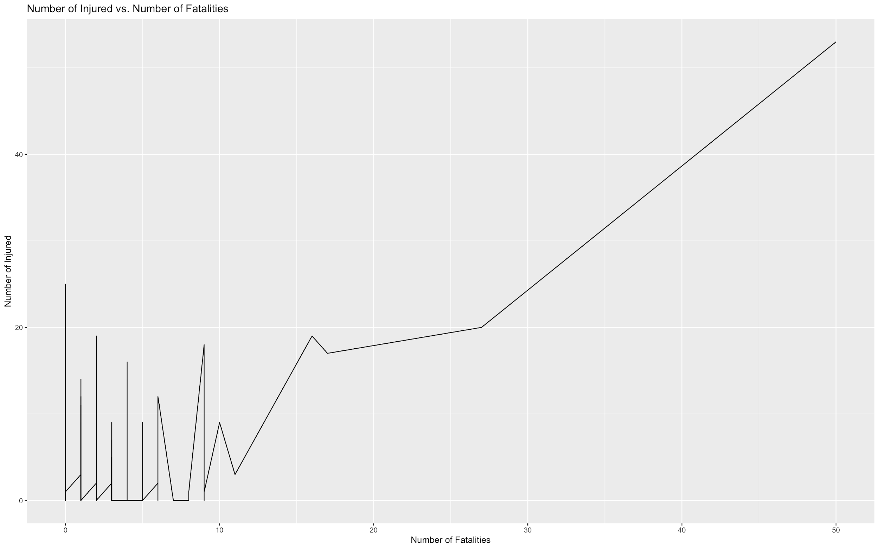
THE TREND BETWEEN THE NUMBER OF INJURED vs NUMBER OF FATALITIES
The positive trend, as shown in the figure, depicts that the number of fatalities and injured people are directly proportional.

Slide 5
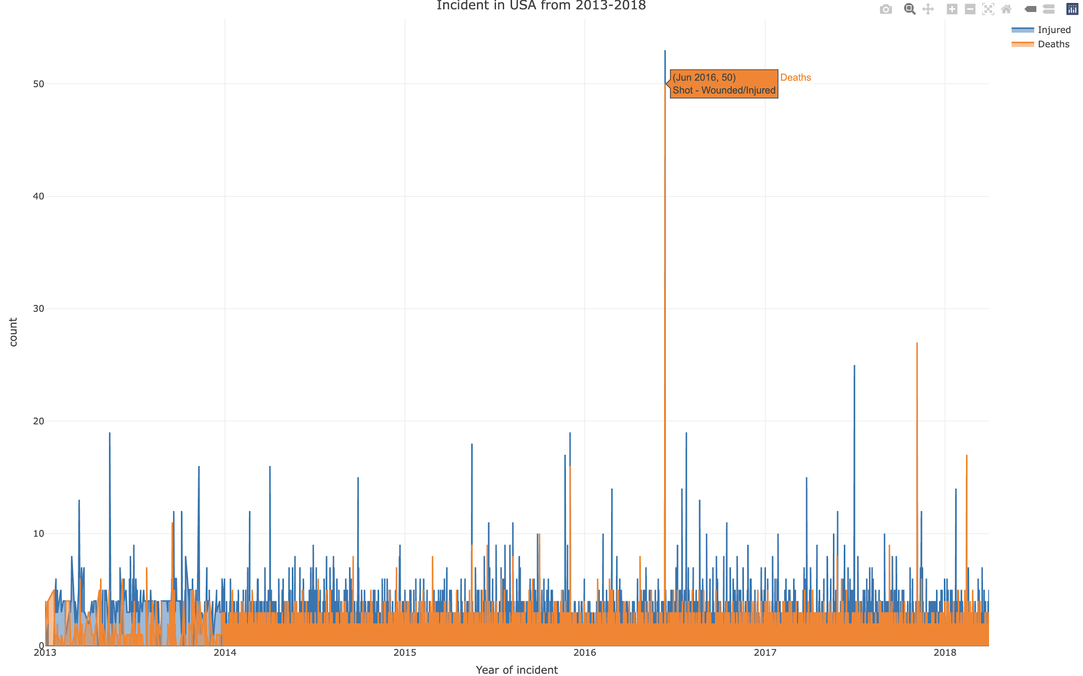
INCIDENTS IN THE U.S.A. 2013-2018
The graph shows the number of incidents that have occurred due to Gun Violence, from 2013-2018.

Slide 6
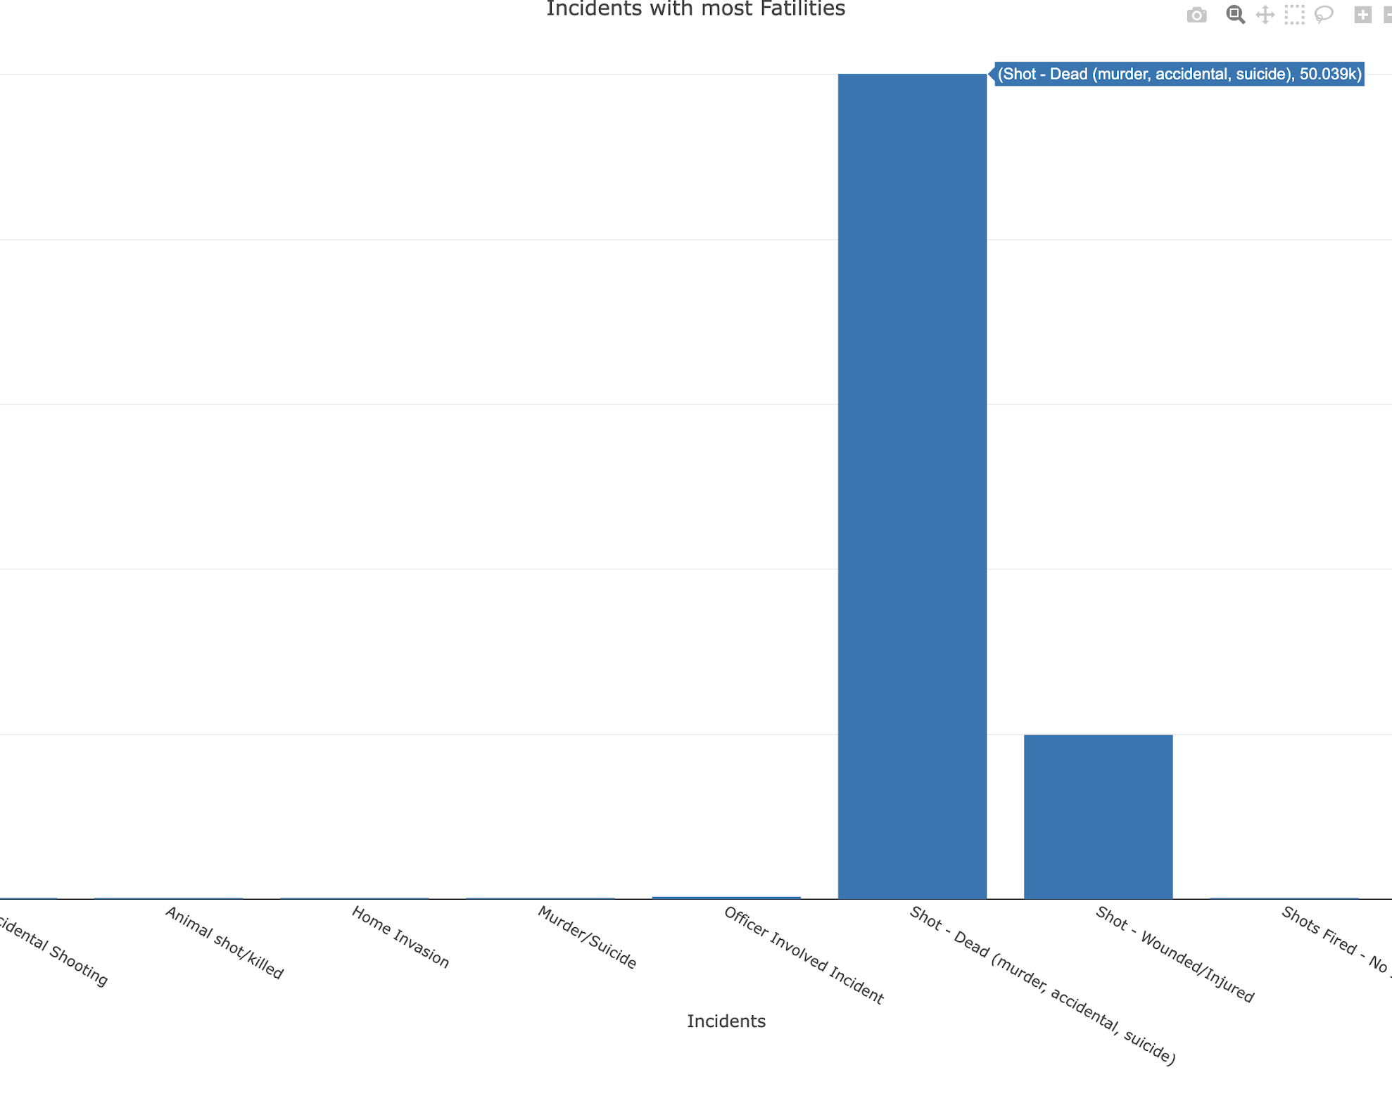
INCIDENTS THAT CAUSED MOST FATALITIES
This graph shows the number of incidents that took place between 2013-2018.
The number of fatalities caused by Gun Violence, is around 50,039 deaths.
Maximum number of fatalities were caused either by an accidental gun shot, or by murder, or gun fired during suicide.

Slide 7
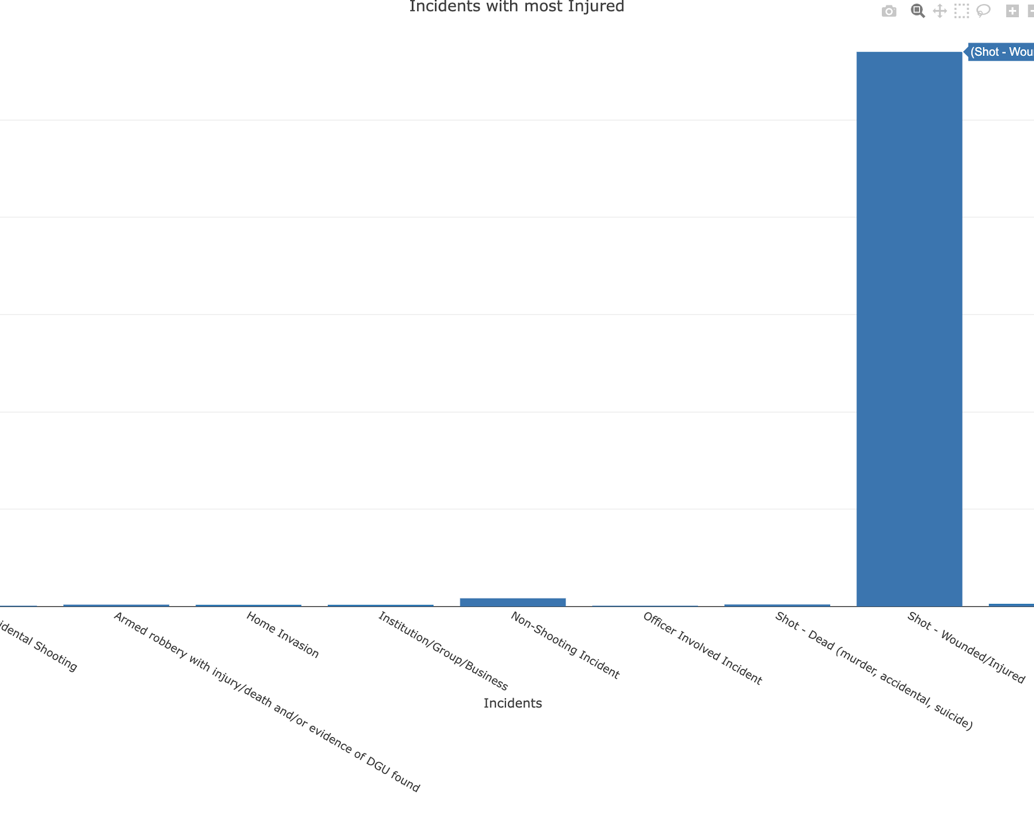
INJURIES DUE TO GUN VIOLENCE
The graph depicts the number of people that were injured during a gun violence incident.
By looking at the graph we can see that around 113,987 people were left injured due to Gun Violence.

Slide 8
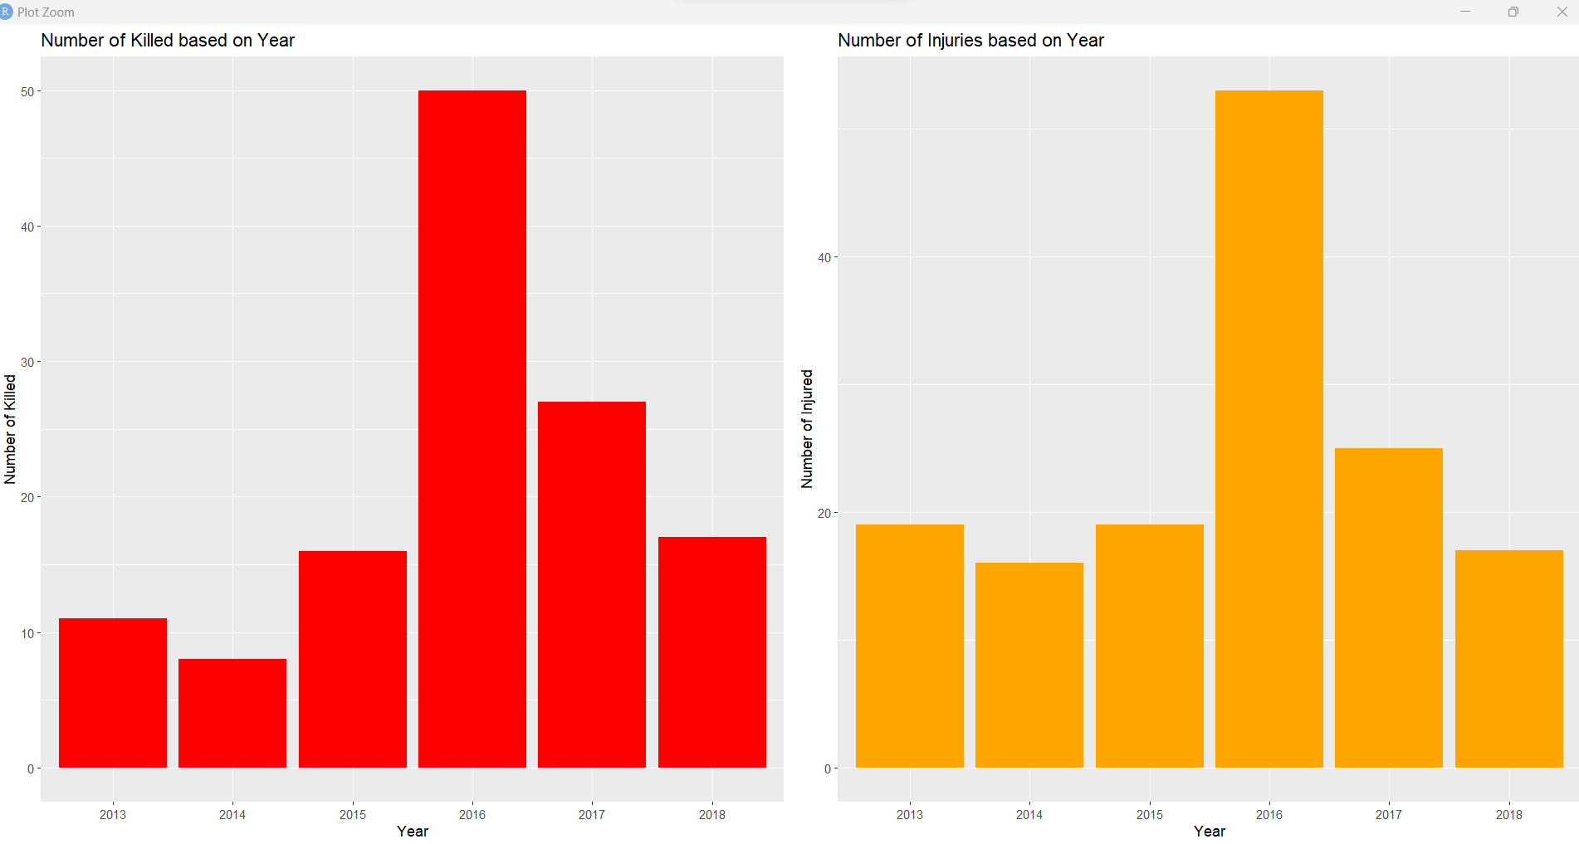
HOW HAS GUN VIOLENCE CHANGED OVER TIME?
From our visualization, we can observe that there were more killings in the year 2016 than any other year, with the second-highest number of killings occurring in 2017.
Similarly, the graph also shows that the year 2016 had the highest number of injuries caused by gun violence, with the second-highest number of injuries occurring in 2017.
These findings suggest that 2016 and 2017 were particularly dangerous years in terms of gun violence in the U.S., highlighting the urgent need for effective measures to address this issue and improve public safety.

Slide 9
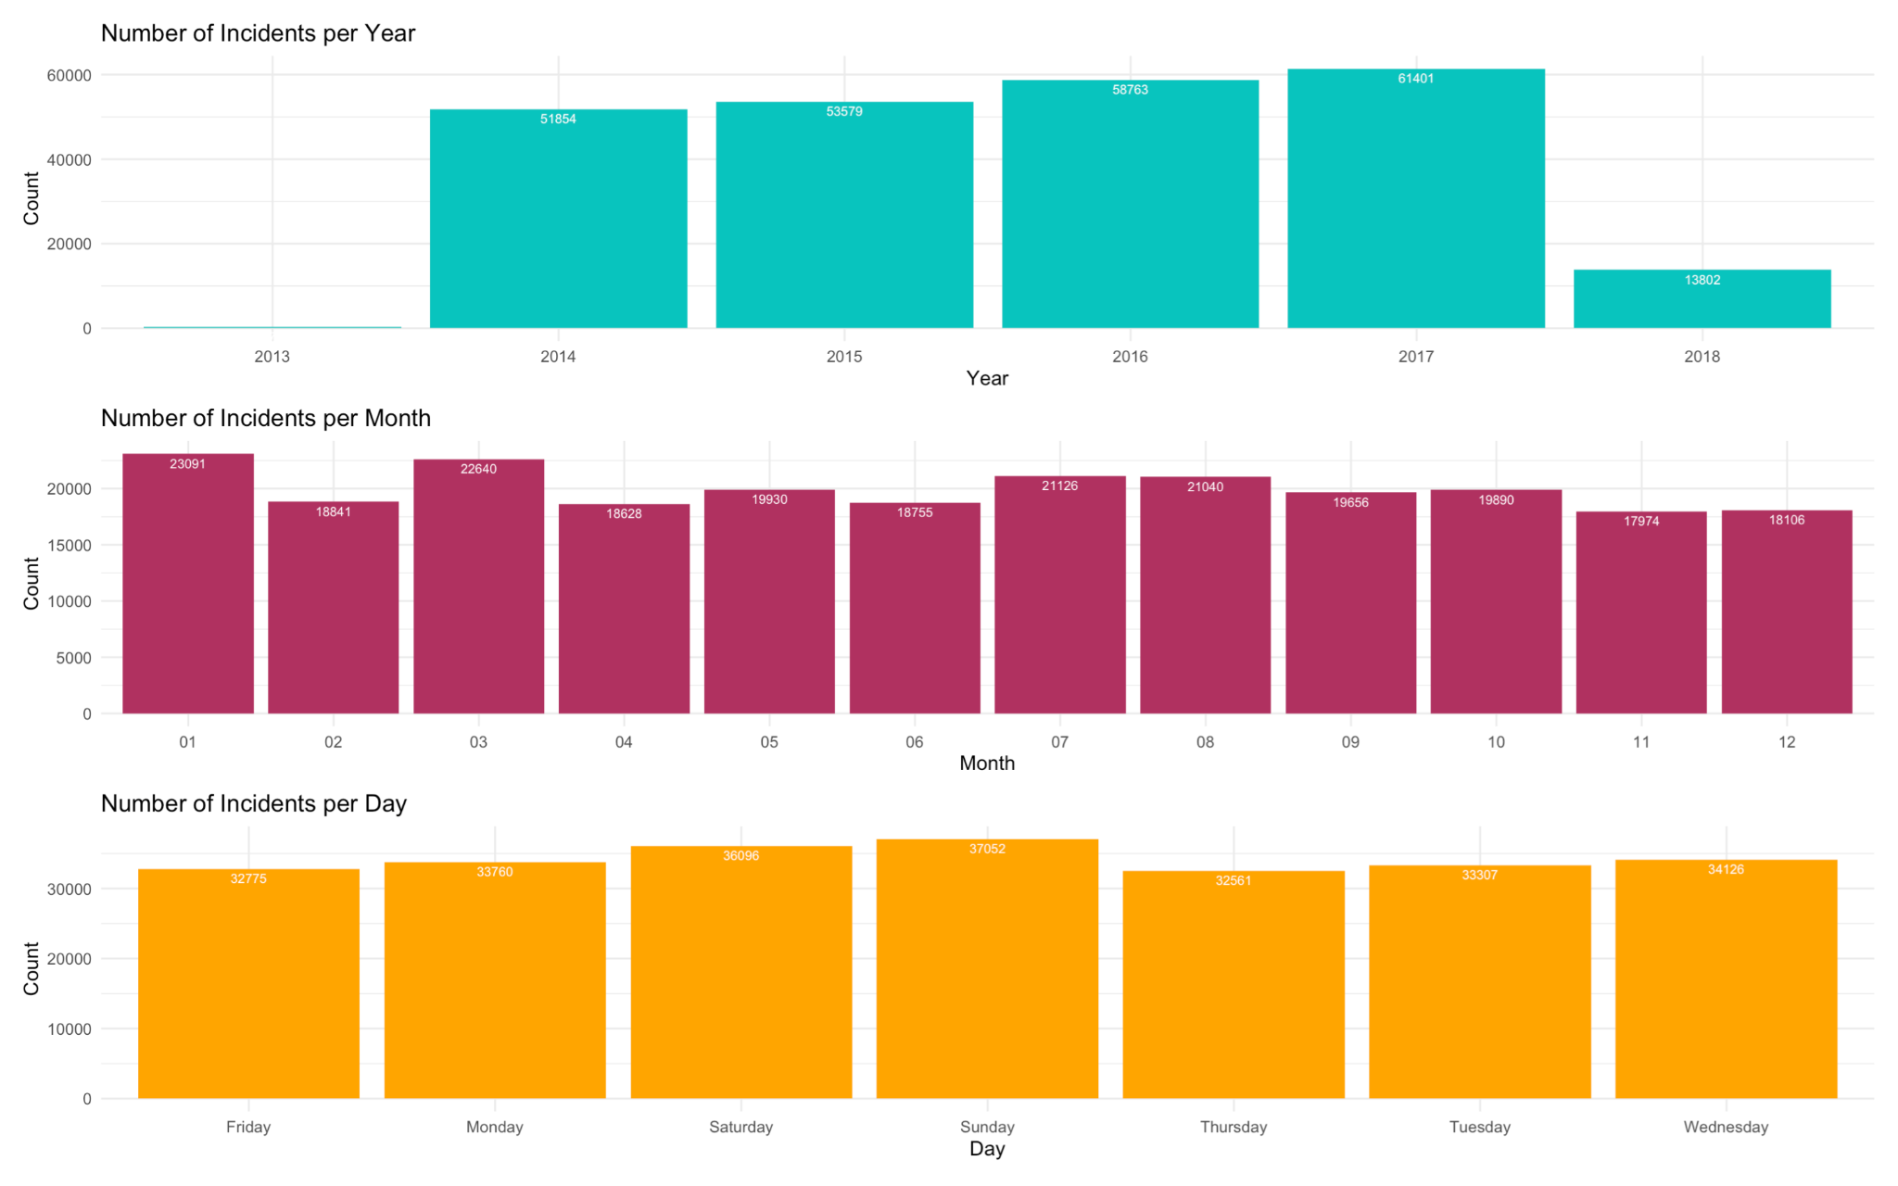
Temporal patterns of gun violence incidents in the United States
There has been an increase in Gun Violence crimes since 2013- 2017.
Monthly statistics show January and March being the most active months for Gun Violence Crimes.
The trend shows crime the days when Gun Violence crime is most likely to occur indicating Weekends as most susceptible to Gun Violence Crime.

Slide 10
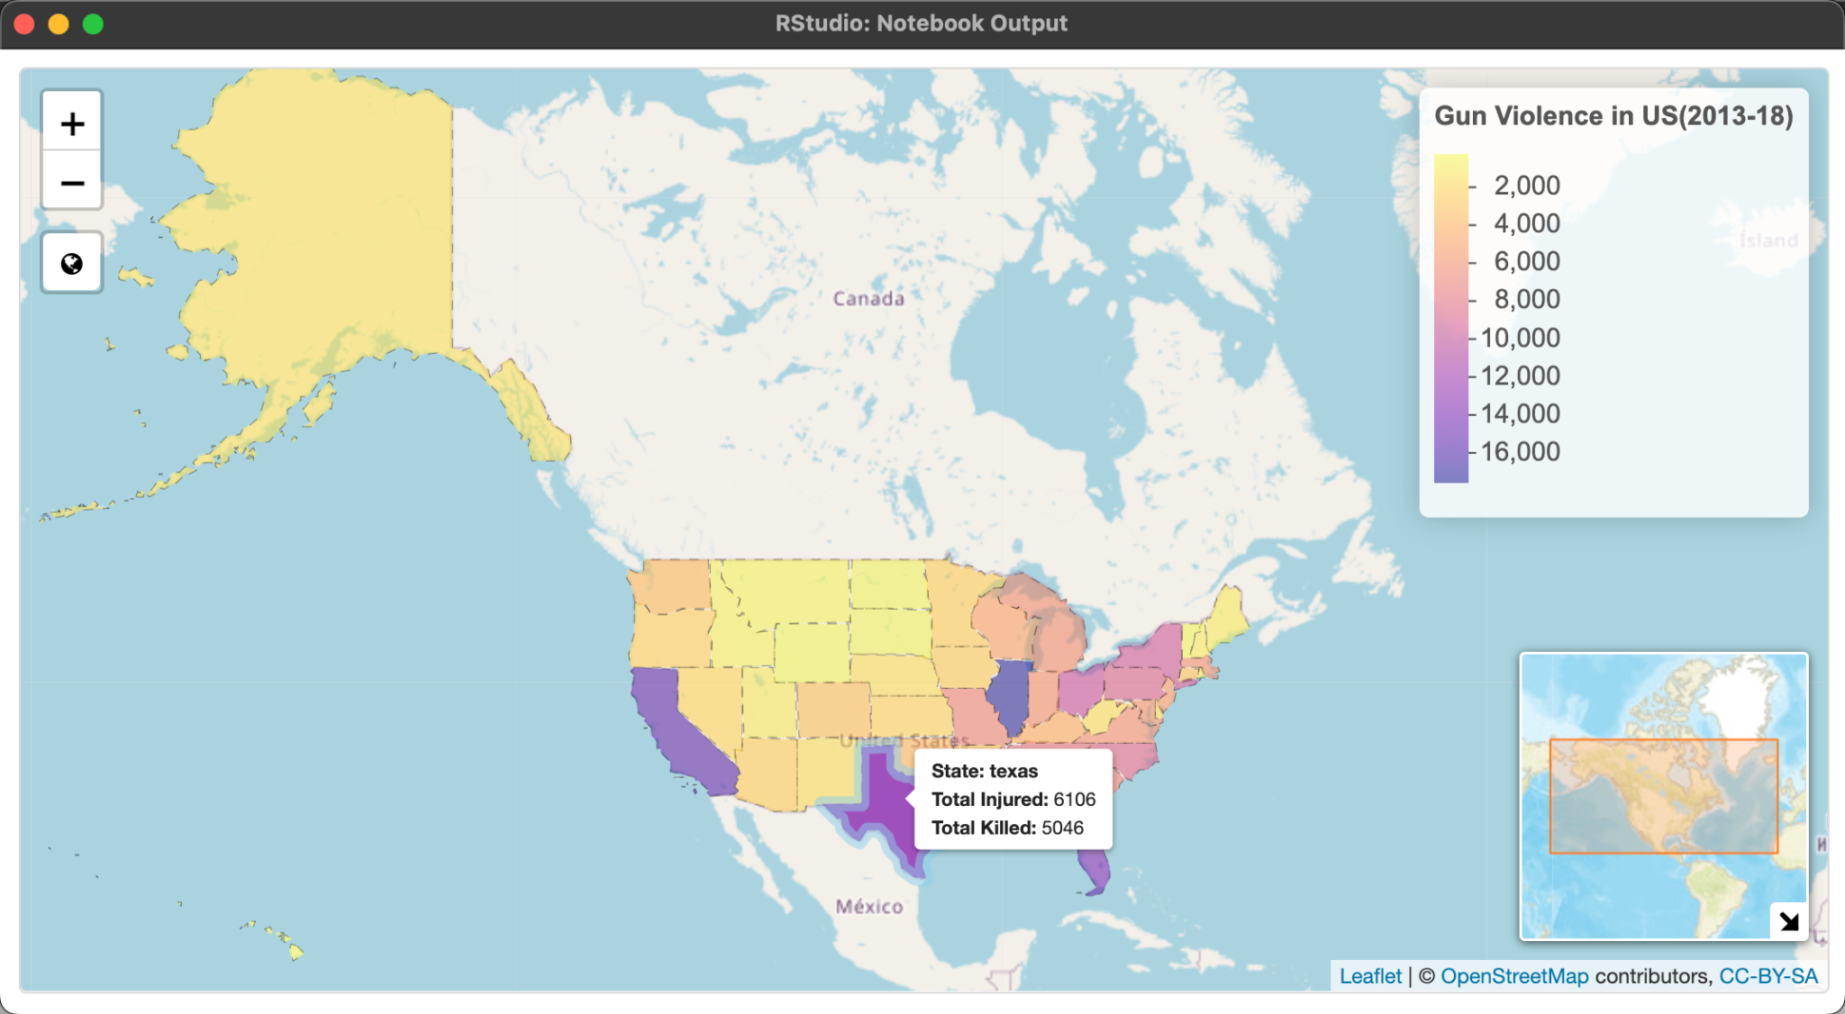
Geographic patterns of gun violence incidents in the United States

Slide 11
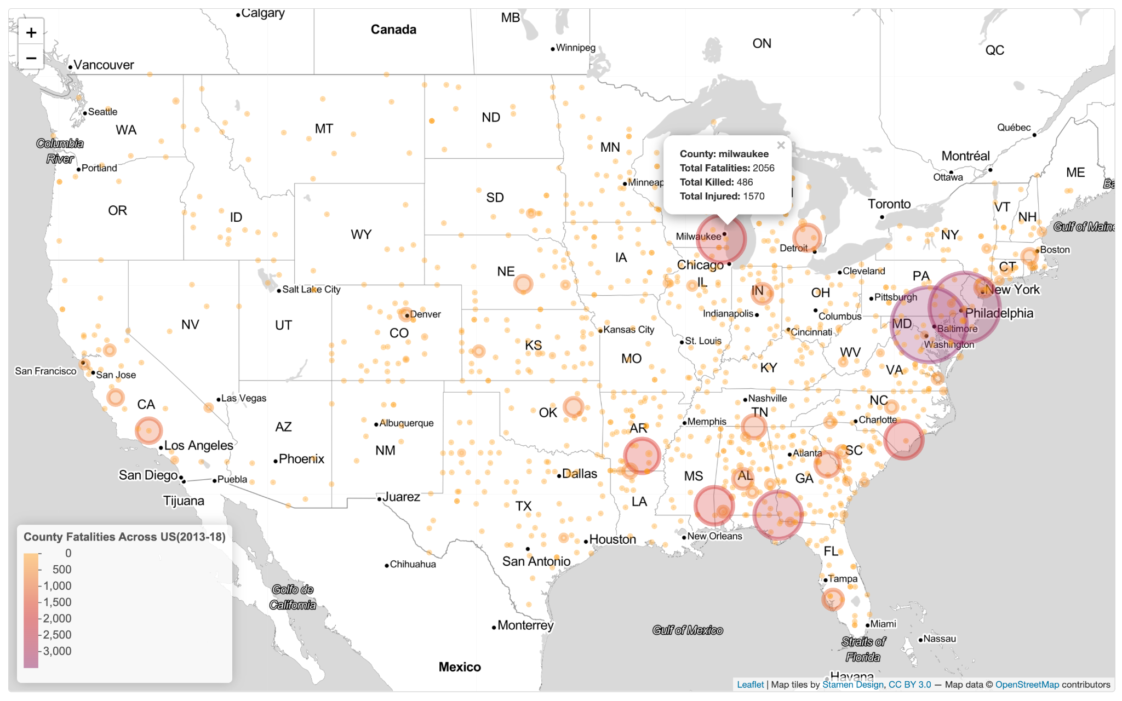
County-wise Fatalities Comparison

Slide 12
CONCLUSION
From the above graphs, we can summarise that the Gun Violence has shown an upward trend and although there have been many measures taken against reducing the crime, there haven’t been any effective changes.
This visualizations can be utilised in overcoming the trends and patterns found in this incidents and strict policies can be implemented for Gun licences distributed over the hotspot areas from above maps.
Some other measures which can be taken include spreading awareness among people residing in these zones to inform about any suspicious activities, providing mental health seminars, addressing root causes, enhancing school safety and many more.

